Slide 1
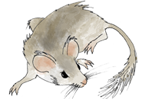

Introduction to Paleoecoinformatics & the Neotoma Paleoecology Database
Jack Williams, Eric C. Grimm, Jessica Blois, Simon Goring, Alison Smith, Joaquin Arroyo-Cabrales, Allan Ashworth, Julio Betancourt, Jessica Blois, Bob Booth, Phil Buckland, Don Charles, Steve Crawford, Brandon Curry, Ed Davis, Thomas Giesecke, Russ Graham, Steve Jackson, Rob Roth, Mike Stryker, et al.
Geoinformatics,
EarthCube
Notes:
Thank you.
Acknowedge collaborators.
Talk in two parts.
First, talk about building community data networks in paleoecology – as example of larger class of activities that I call community curated database
Second, show the kind of large-scale synthetic science that is enabled with open high-quality data platforms, using PalEON as an example.

Slide 2

Macro-scale global-change ecology now requires collaboration among at least four groups
STATISTICS
FIELD/LAB DATA
MODELS
INFORMATICS
Neotoma DB
Notes:
Not to belabor the point, but note that the data and models don’t talk to each other directly anymore.
Statistics:
Characterize uncertainty
Informatics:
Maximize data availability
Maximize research power
Maximize reproducibility

Slide 3
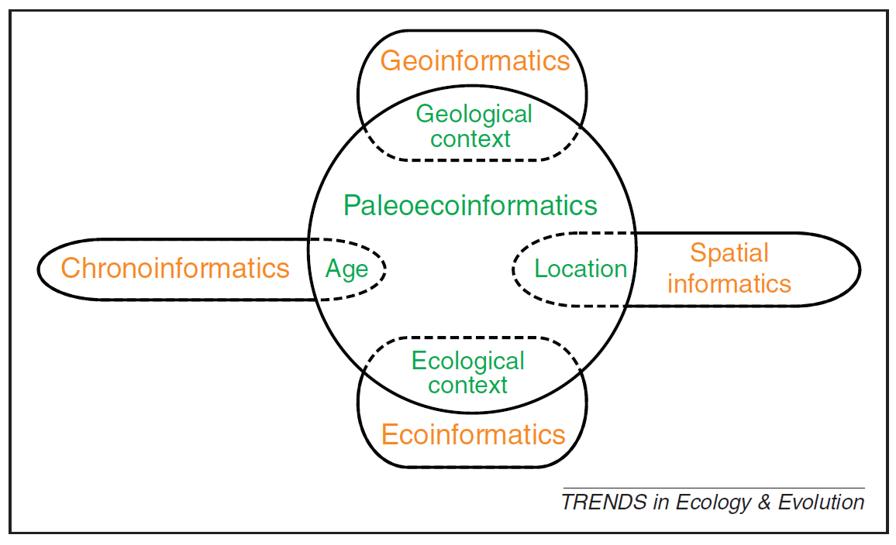
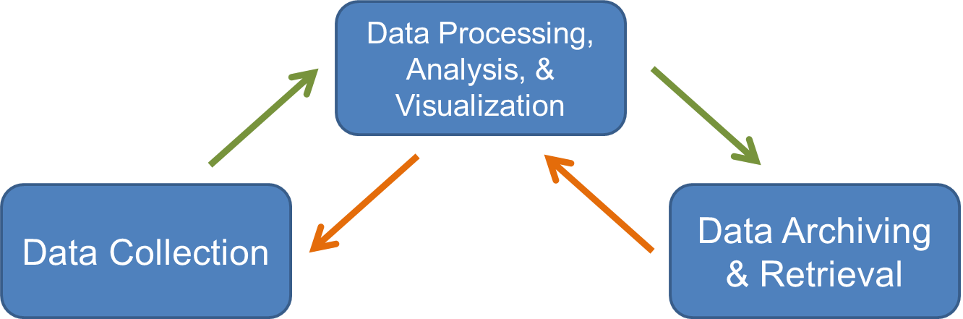
Informatics: designing systems that deliver the right information, to the right person in the right place and time, in the right way. (Wikipedia)
Paleoecoinformatics: the collection, organization, analysis, synthesis, and curation of paleoecological data
Brewer et al. 2012 TREE

Slide 4
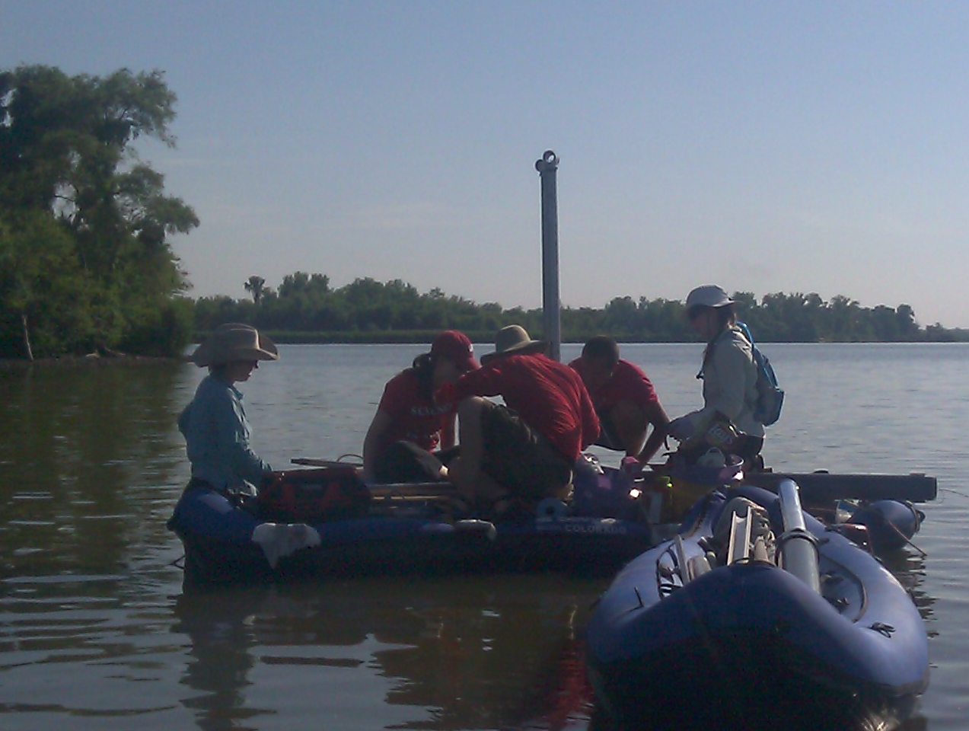
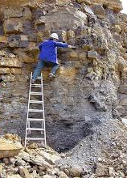
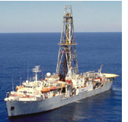
Paleodata: Key characteristics
‘Long Tail’: Collected in the field & lab by many individuals and scientific teams.
Heterogeneity: Many kinds of measurements & methods
Distributed Scientific Expertise by proxy type, archive type, region, time period, and/or taxonomic group
Commonality: All involve measurements of proxies in various geological archives by depth, from which we estimate time.
Long Shelf Life: specimens & samples collected decades ago can be re-analyzed
Bad News
Good News

Slide 5
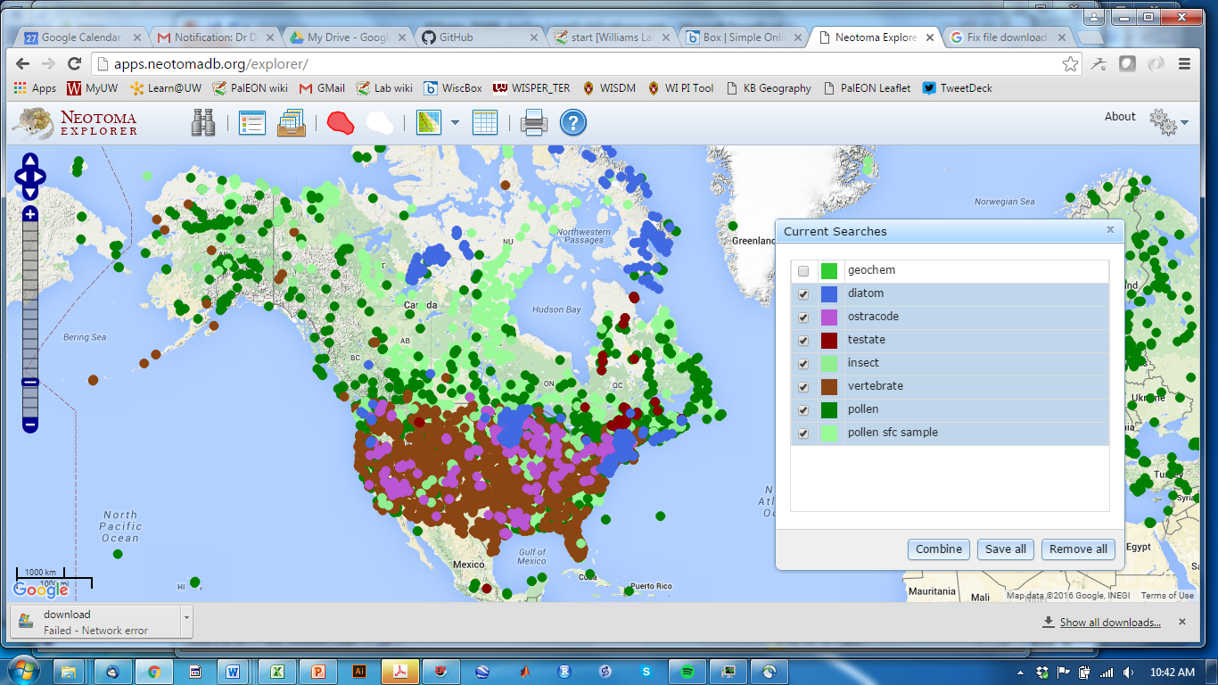
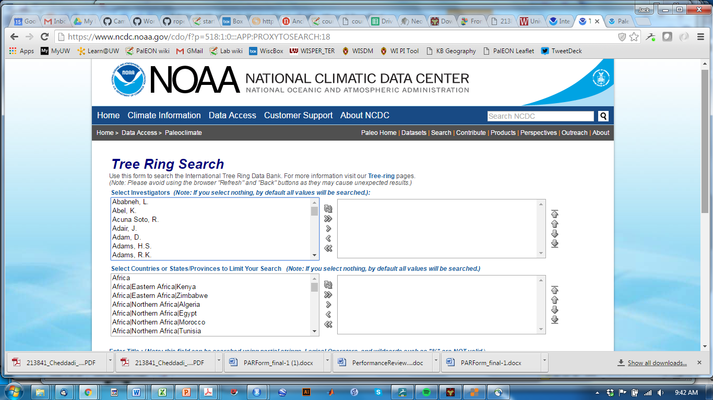
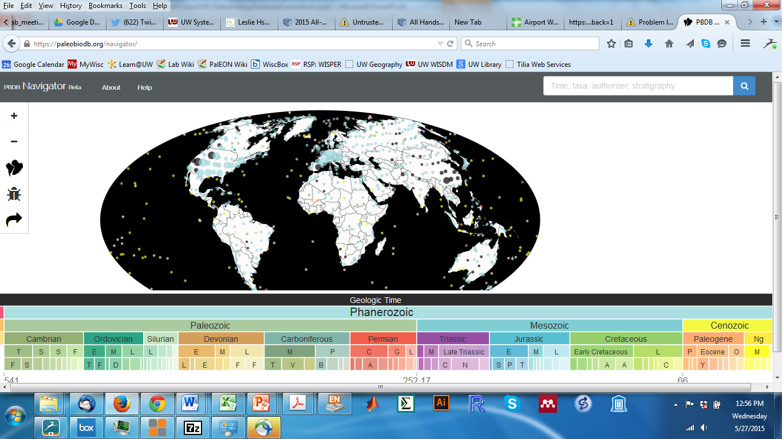
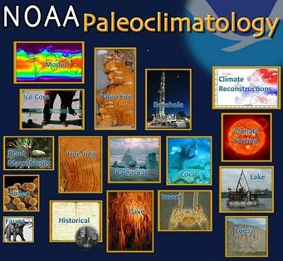
Community Curated Data Repositories (CCDRs) have emerged to tackle macro-scale questions
Characteristics
Open data
Developed by domain scientists
Started to support specific research questions, evolve from there
Add value via discipline-specific metadata, variable names, etc.
Neotoma DB
ITRDB
Paleobiology DB
paleobiodb.org

Slide 6
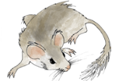
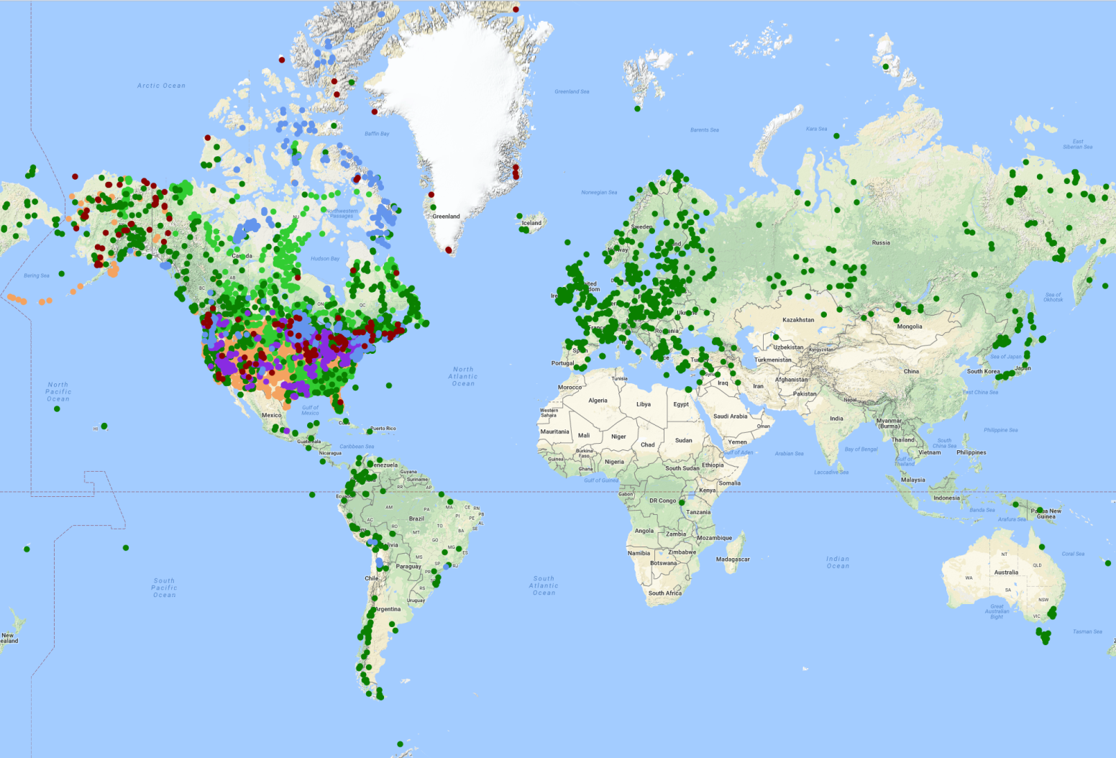
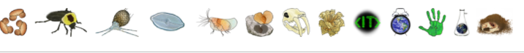
Neotoma Paleoecology Database
Neotoma DB
Mission: Support global-change research by providing an open, community-curated repository for multiple kinds of paleoecological data
Key Characteristics
Open Data
Curated by Community -> High-Value Data
Standardized Variable Names & Taxonomy
Flexible data models for sites, proxies, cores, etc.
Time: Age Controls and Age Models
>3.8 million observations
>18,900 datasets
>10,000 sites
www.neotomadb.org
Williams, Grimm et al. 2018Quaternary Research

Slide 7
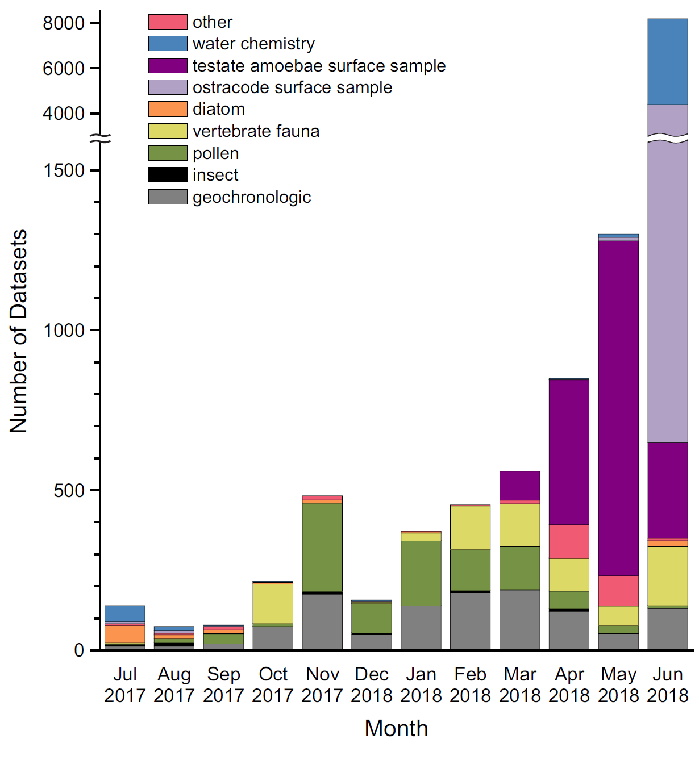
Data Uploads: Last 12 months
Current Holdings (Datasets)
6,516 pollen
5,297 water chemistry
4,600 vertebrate
4,515 ostracode
1,886 testate amoebae
1,120 diatom
295 plant macrofossil
218 insect
Constituent Databases
Diatom: Drexel
Ostracode: Delorme, NANODe
Pollen: EPD, NAPD, LAPD
Vertebrates: FAUNMAP2
Notes:
Includes surface samples!

Slide 8



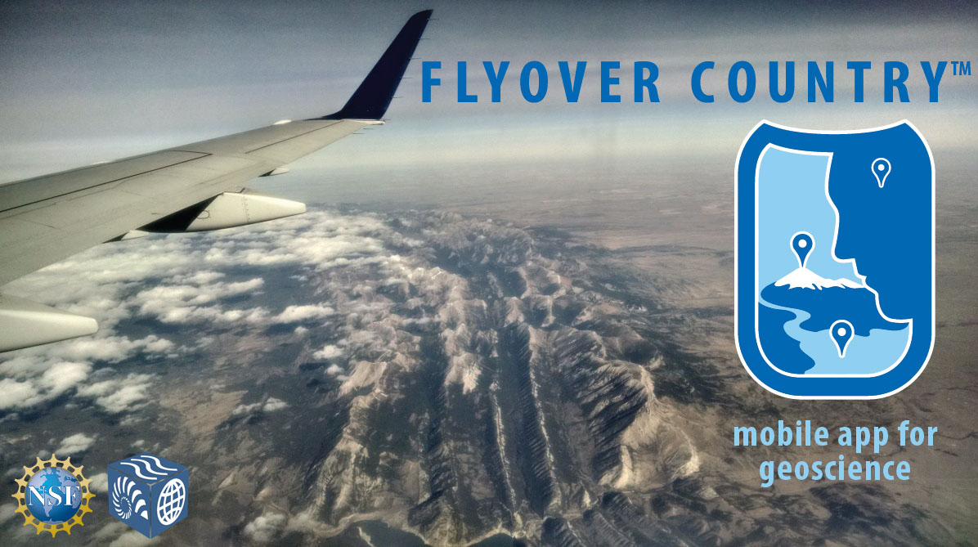

Neotoma Accreditations & Partnerships
Accreditations
Partnerships

Slide 9
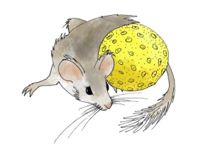
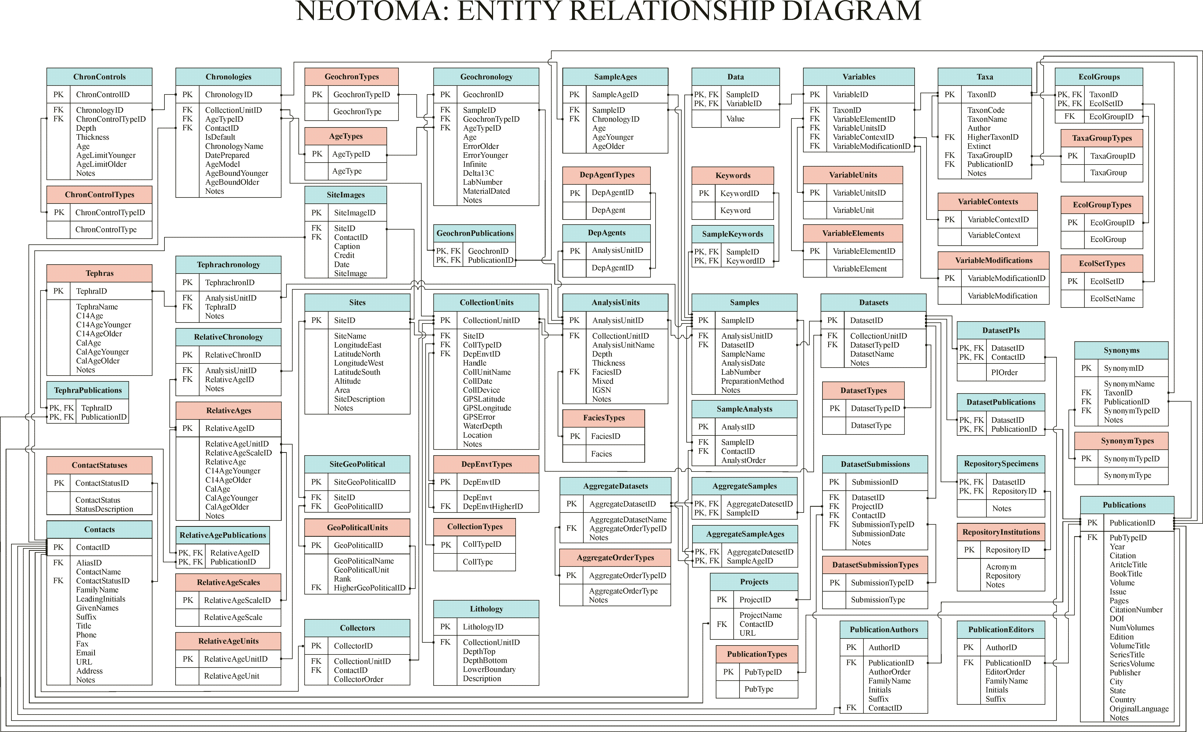
2. Key Concepts & Data Model
Database Structure
https://neotoma-manual.readthedocs.io/en/latest/

Slide 10
Key Concepts: Sites, Collection Units, Analysis Units, Samples, Datasets
Sites
CollectionUnits
AnalysisUnits
Samples
Datasets
SiteID
SiteName
LongitudeEast
LatitudeNorth
LongitudeWest
LatitudeSouth
Altitude
Area
SiteDescription
Notes
CollectionUnitID
SiteID
CollTypeID
DepEnvtID
Handle
CollUnitName
CollDate
CollDevice
GPSLatitude
GPSLongitude
GPSError
WaterDepth
Location
Notes
AnalysisUnitID
CollectionUnitID
AnalysisUnitName
Depth
Thickness
FaciesID
Mixed
IGSN
Notes
SampleID
AnalysisUnitID
DatasetID
SampleName
AnalysisDate
LabNumber
PreparationMethod
Notes
DatasetID
CollectionUnitID
DatasetTypeID
DatasetName
Notes
One site may have many collection units
One collection unit may have many analysis units
One analysis unit may have many samples
A dataset comprises all samples of same type from same collection unit

Slide 11
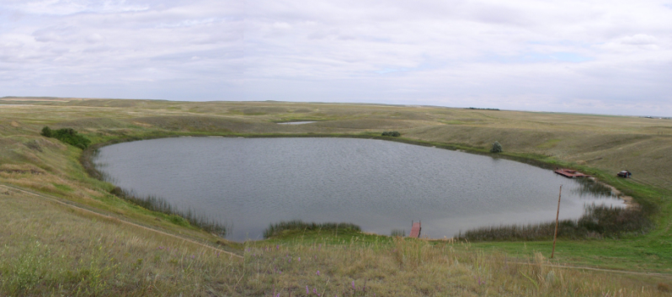
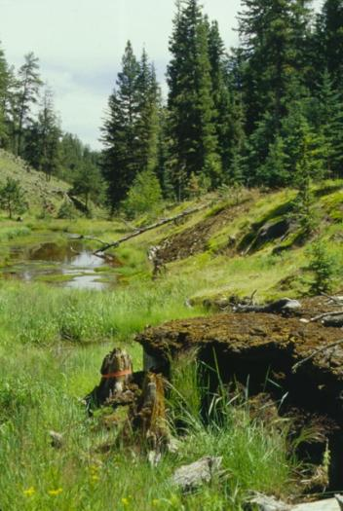
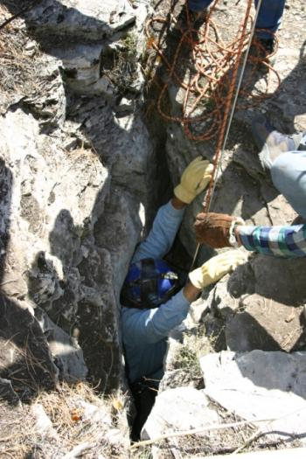
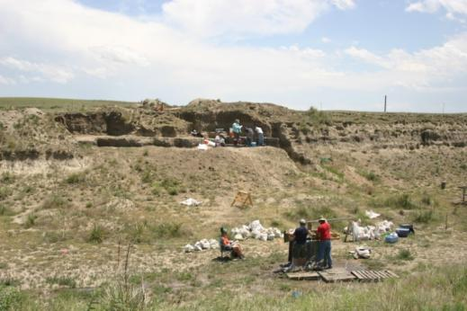
Sites
Sites Table
Lakes
SiteID
SiteName
LongitudeEast
LatitudeNorth
LongitudeWest
LatitudeSouth
Altitude
Area
SiteDescription
Notes
Sections
Caves
Archaeological Digs

Slide 12
Collection Units
Sites
CollectionUnits
Examples
Multiple cores w/in a lake
Multiple pits w/in an archaeological dig
Multiple bone piles within a cave
etc.
SiteID
SiteName
LongitudeEast
LatitudeNorth
LongitudeWest
LatitudeSouth
Altitude
Area
SiteDescription
Notes
CollectionUnitID
SiteID
CollTypeID
DepEnvtID
Handle
CollUnitName
CollDate
CollDevice
GPSLatitude
GPSLongitude
GPSError
WaterDepth
Location
Notes

Slide 13
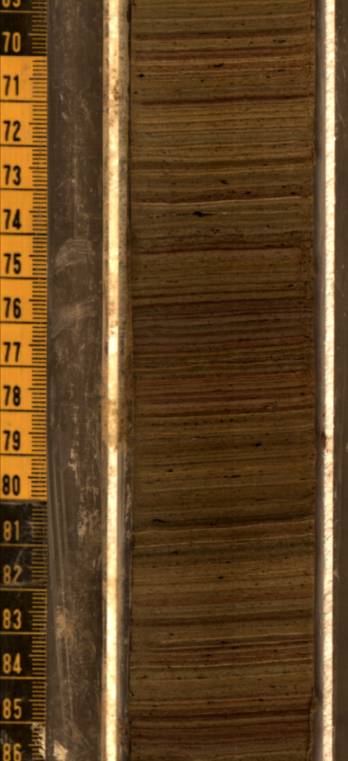
Analysis Units
CollectionUnits
AnalysisUnits
CollectionUnitID
SiteID
CollTypeID
DepEnvtID
Handle
CollUnitName
CollDate
CollDevice
GPSLatitude
GPSLongitude
GPSError
WaterDepth
Location
Notes
AnalysisUnitID
CollectionUnitID
AnalysisUnitName
Depth
Thickness
FaciesID
Mixed
IGSN
Notes
Analysis units have a depth and thickness
Example: depths within a sediment core

Slide 14
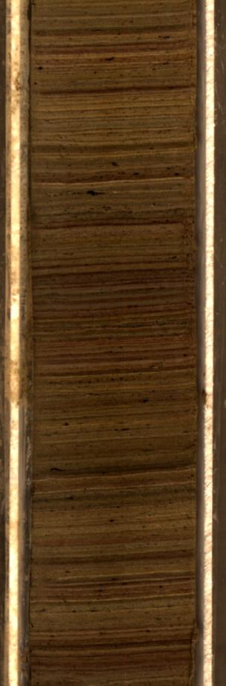
Samples
AnalysisUnits
Samples
AnalysisUnitID
CollectionUnitID
AnalysisUnitName
Depth
Thickness
FaciesID
Mixed
IGSN
Notes
SampleID
AnalysisUnitID
DatasetID
SampleName
AnalysisDate
LabNumber
PreparationMethod
Notes
Pollen
Charcoal
Diatoms
Loss-on-ignition
Example: pollen, charcoal, diatom samples from a single depth interval in a core

Slide 15
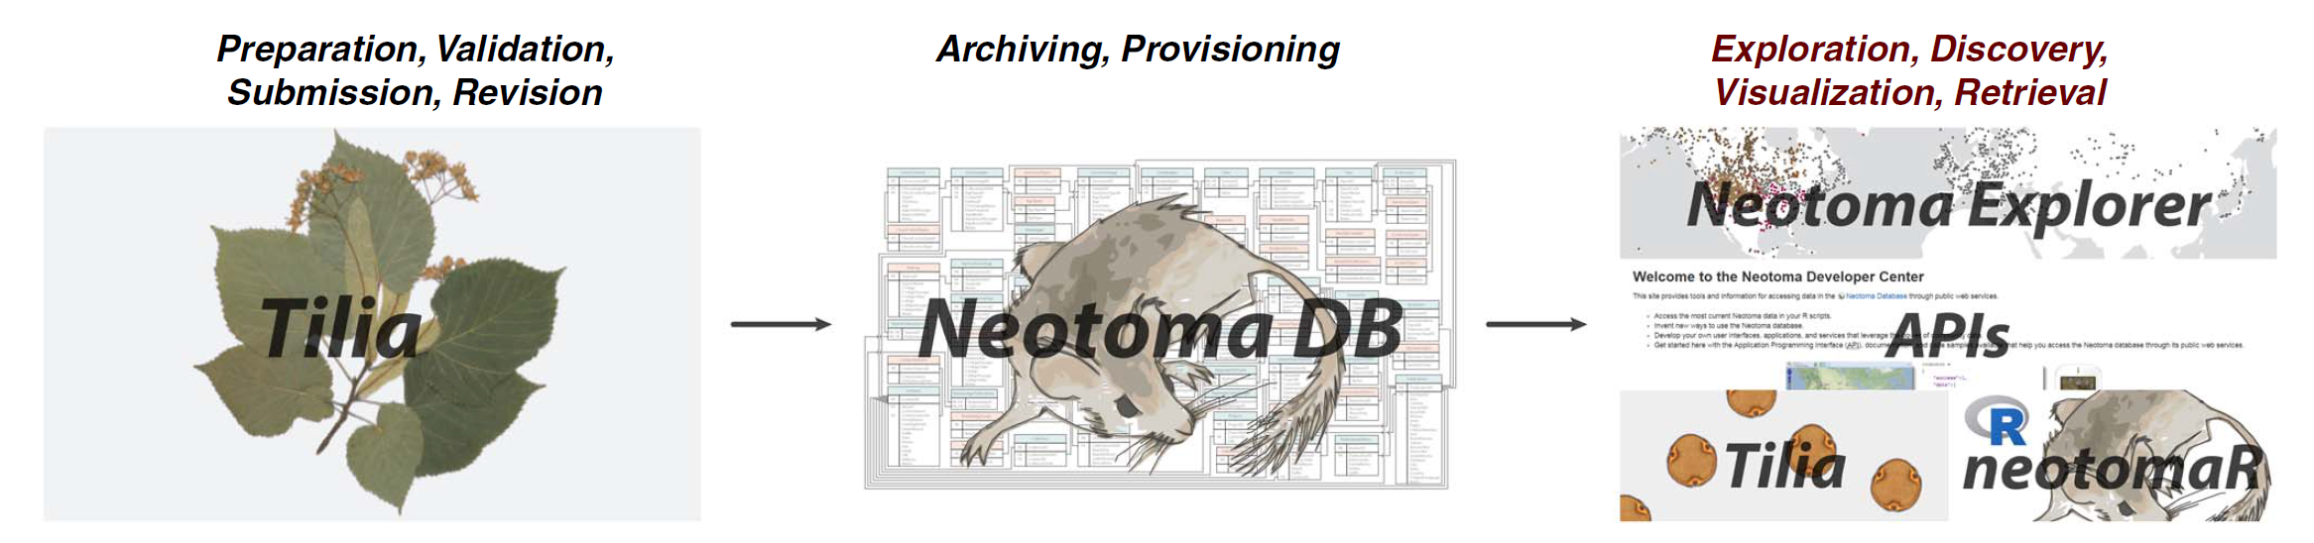
Neotoma: Software Ecosystem

Slide 16
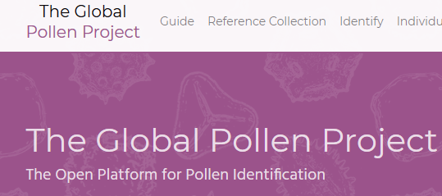
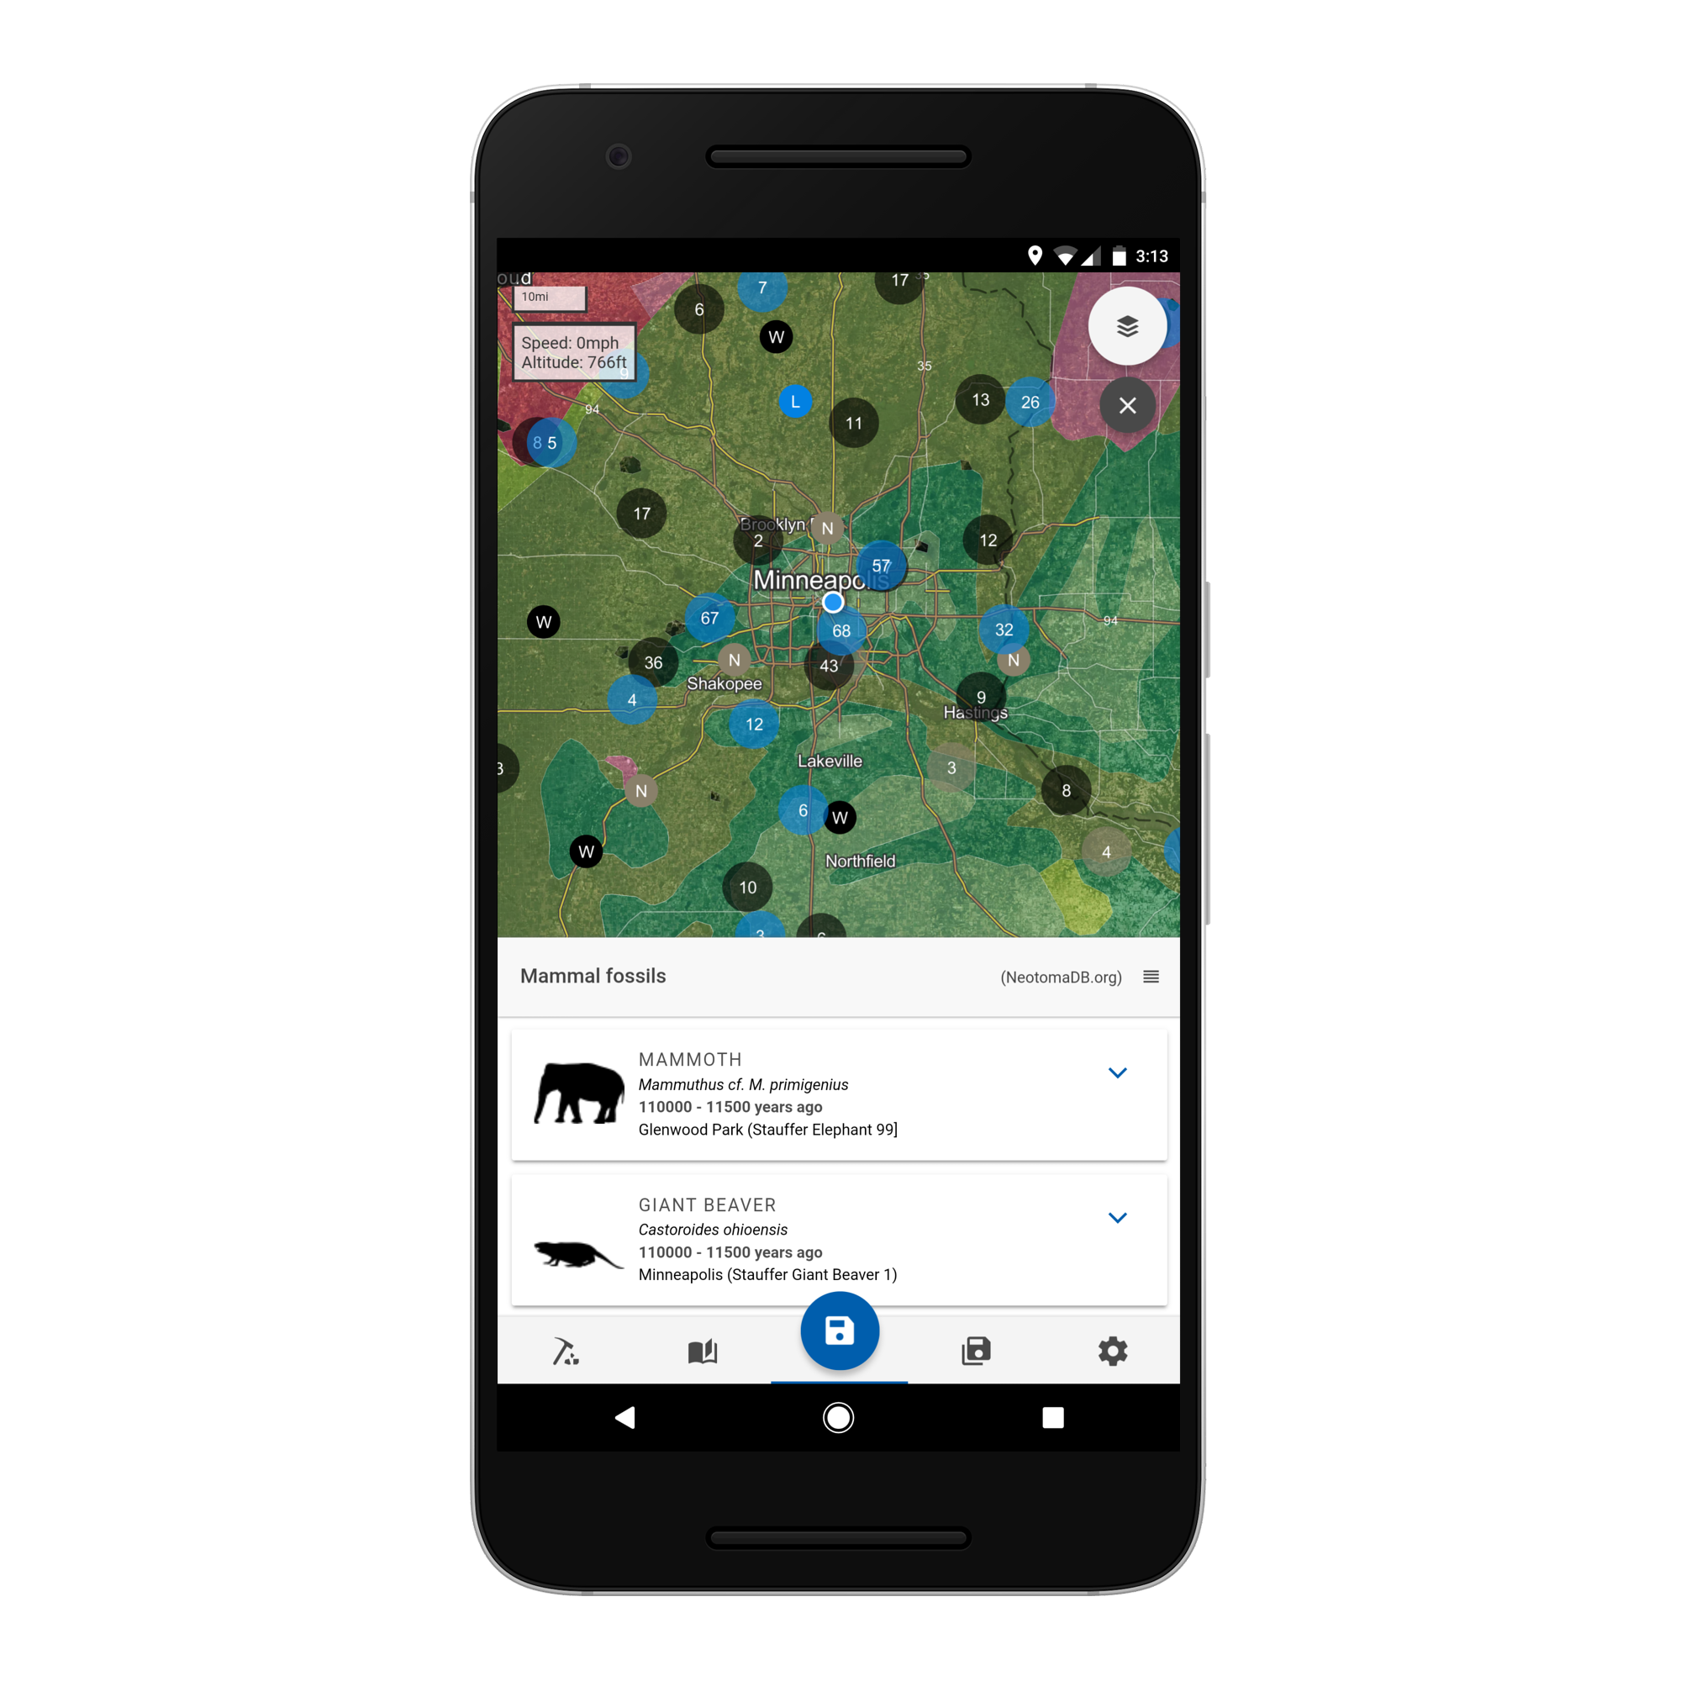
Neotoma: Software Ecosystem
NOAA/WDC-Paleo
Earth-Life
Consortium
Global Pollen
Project
Flyover Country

Slide 17
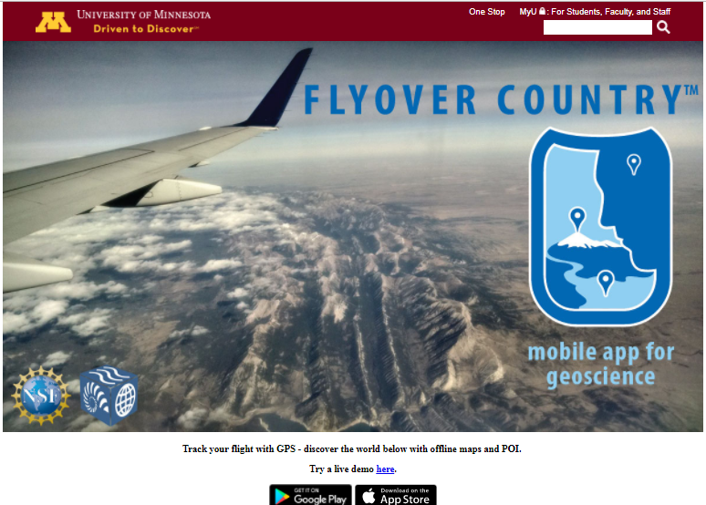
Neotoma Software Ecosystem
Neotoma Software Ecosystem
Third-Party Developers
Williams, Grimm, et al. 2018 QR

Slide 18
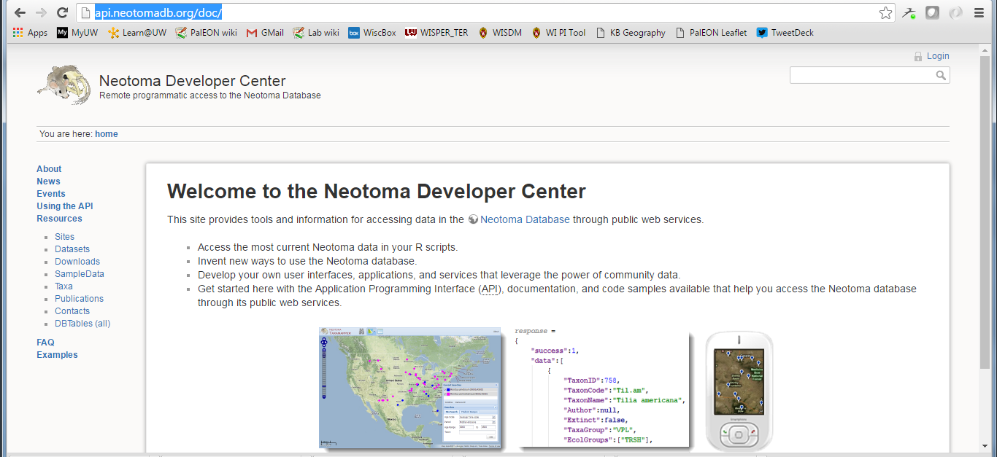
Tilia (Putting Data into Neotoma)
Neotoma DB
www.neotomadb.org
Free Download: http://www.tiliait.com/download/
Manual:

Slide 19
Neotoma Explorer (Finding/Exploring/Getting Data)
Neotoma DB
www.neotomadb.org
Walk-Through Teaching Exercise, Neotoma Explorer
http://serc.carleton.edu/neotoma/activities.html

Slide 20
Neotoma APIs (Finding/Exploring/Getting Data)
Neotoma DB
www.neotomadb.org
APIs & Documentation available at:
http://api.neotomadb.org/doc/

Slide 21
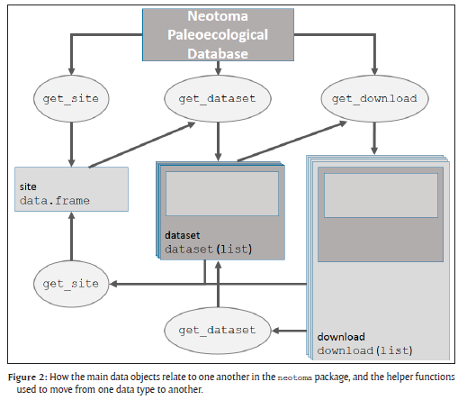
Neotoma R Porting Neotoma data to R environment
Key Functions
get_site
get_dataset
get_download
get_chroncontrol
get_table
get_taxa
Other Functions
get_closest
get_contact
get_publication
GitHub Repository: https://github.com/NeotomaDB/neotoma
Example Workflows: XXEDIT HERE
Goring et al. 2015 Open Quaternary

Slide 22




Earth-Life Consortium & ePANDDA APIs
Linking Fossil Occurrence DBs
Linking Fossil DBs
to Specimens
ELC APIs: Documentation & Sandbox
http://earthlifeconsortium.org/docs/api-docs.html

Slide 23


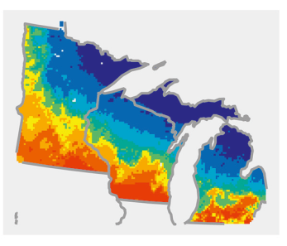

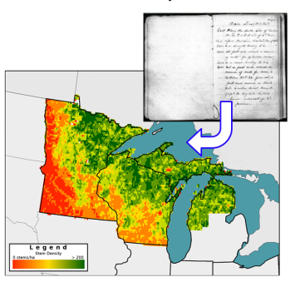
Leveraging Neotoma for new research syntheses: PalEON example
Data cleaning,
standardization,
upload
Individual Data Contributors
Hotchkiss, Calcote, & Lynch
Hupy & Yansa
Booth & Jackson
Cushing
St. Jacques
Neotoma DB
R
neotoma
Rebuild age
models (bacon)
STEPPS
Pollen
Paleoveg.
Witness Tree
Data
Reconstrux
w/ uncertainty
Vegetation
Goring et al. (2015) Open Quaternary
Goring et al. (in press) PLoS One
Dawson et al. (2016) QSR

Slide 24
Neotoma Resources: Summary
QR Paper
Williams, Grimm, et al (2018) The Neotoma Paleoecology Database: A multi-proxy, international community-curated data resource. Quat. Res. 89:156-177.
Neotoma APIs
http://api.neotomadb.org/doc/
Neotoma Explorer
http://apps.neotomadb.org/explorer/
Walk-Through Teaching Exercise, Neotoma Explorer
http://serc.carleton.edu/neotoma/activities.html
Tilia
http://www.tiliait.com/download/
Neotoma R
CRAN, Goring et al. 2015 Open Quaternary
Neotoma Database Manual
https://neotoma-manual.readthedocs.io/en/latest/tables_contacts.html
ELC APIs
http://earthlifeconsortium.org/docs/api-docs.html
Flyover Country
https://flyovercountry.io/
Join as Member:
https://tinyurl.com/NeotomaMember
Contribute Data: https://www.neotomadb.org/data/category/contribution

